Slide 1




NEXT GEN EMPLOYABILITY PROGRAM
Creating a future-ready workforce
Team Members
College Name
Student Name :V.Sathya Priya
Student ID : au960221104104
Arunachala College of Engineering For Women

Slide 2

CAPSTONE PROJECT SHOWCASE
Project Title
Car Rentals Application with Django Framework
Abstract | Problem Statement | Project Overview | Proposed Solution | Technology Used | Modelling & Results | Conclusion

Slide 3
Abstract Our Aim is to design and create a data management System for a car rental company . This enables admin can rent a vehicle that can be used by a customer. This system increases customer retention and simplify vehicle and staff Management in an efficient way.This software car Rental System has a very user friendly interface. Thus the users will feel very easy to work on it. By using this system admin can manage customer confirm and cancel booking request, customer Testimonials, customer issues. The car information can be added to the system. Or existed car information can be edited or deleted too by Administrator . There is no delay in the availability of any car information, whenever needed, car information can be Captured very quickly and easily
Source :

Slide 4
Problem Statement Develop a web application for managing car rentals using the Django framework. User Roles: Customer/User: Can browse available cars, make reservations, manage their bookings (view, cancel), and update their profile. Features: Notifications: Send notifications to users regarding booking status updates, promotions, etc. Technology Stack: Backend Framework: Django Security Considerations: Use HTTPS to encrypt data transmission. Testing: Perform unit tests for individual components. Optional Features: Social media authentication for user login.
Source :

Slide 5
Project Overview A car rental company lends autos for a price for a few hours, a few days, or a week or more. Overview of Car Rental System: The project's goal is to automate vehicle rental and reservation so that clients don't have to waste time calling and waiting for a vehicle.
Source :

Slide 6
Proposed Solution Setup Django Project: Install Django using pip: ‘pip install django’ Create a new Django project: ‘django-admin startproject car_rental’ Create a new Django app within the project for the rental functionality: ‘python manage.py startapp rentals’. Define Models: Define models for cars, bookings, users, etc. in the models.py file of the rentals app. Use Django's built-in User model or extend it for user authentication and profile management. Configure URLs: Define URL patterns in the urls.py file of the project and the app to map URLs to views. Use Django's URL naming to make URL management easier.
.
Source :

Slide 7
Implement Forms: Create Django forms for user input validation and handling. Utilize Django's ModelForms for forms related to models.
Testing: -
Write unit tests for models, views, forms, etc.
Conduct integration tests to ensure different parts of the application work together correctly.
This is a high-level overview of the solution for a car rental application using Django. Each step needs to be implemented with attention to detail, and additional features can be added based on specific requirements and preferences.
Source :

Slide 8
Source :

Slide 9


Technology Used
Front-end
Back-end
Source :

Slide 10
Modelling & Results In our previous article on Django’s MVT architecture, we have done an overview of what Django models are. When a user interacts with a web application through the template, then models are responsible to fulfill the user’s request. The user’s request can either be retrieving some information or making changes to the database.
Source :

Slide 11
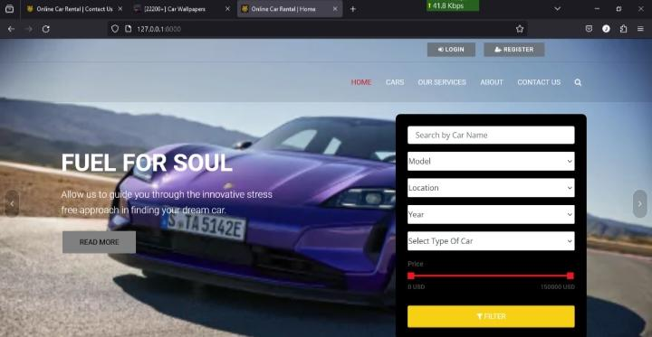
Homepage

Slide 12
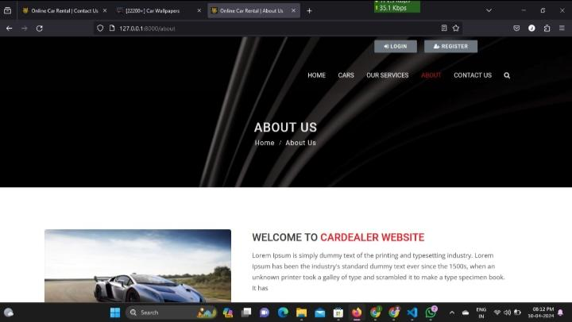
About-Us-Page

Slide 13
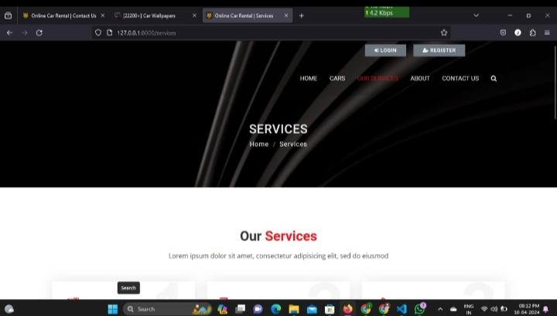
Service-Page

Slide 14
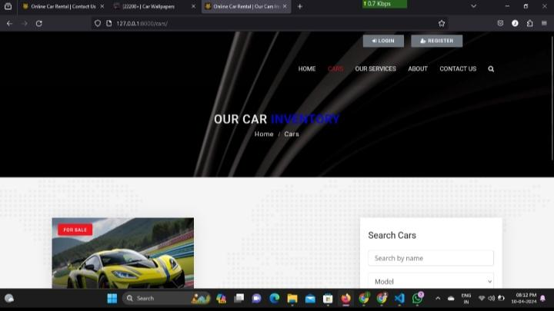
Departments-Page

Slide 15
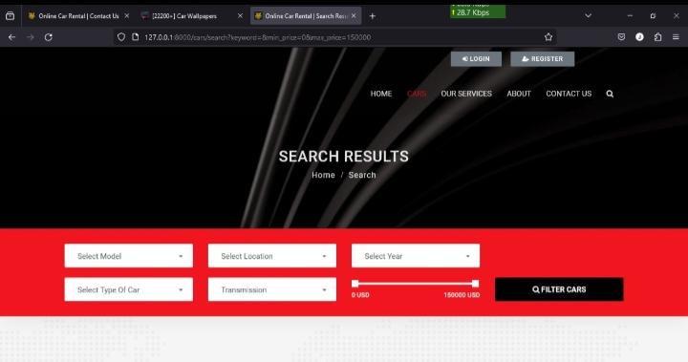
Blog-Page

Slide 16
Future Enhancements:
Future enhancements for the car rental application built with Django framework can significantly improve its functionality, user experience, and overall efficiency. Here are some potential areas for enhancement:
Payment Gateway Integration:
Integrate popular payment gateways like Stripe, PayPal, or Braintree to allow users to make secure online payments for their bookings.
Implement subscription-based models for frequent users or corporate clients.
Advanced Search and Filtering:
Enhance the search and filtering functionality to allow users to find cars based on specific criteria such as price range, model year, fuel type, etc
Implement advanced search options like sorting by popularity, mileage, or user ratings.
By incorporating these future enhancements, the car rental application can stay competitive in the market, attract more users, and provide an exceptional rental experience that meets the evolving needs and expectations of customers.

Slide 17
Conclusion In conclusion, the car rental application built with the Django framework provides a solid foundation for managing car rentals efficiently. Throughout the development process, several key aspects were addressed, resulting in a functional and user-friendly platform. In conclusion, the car rental application with Django framework serves as a powerful tool for managing car rentals effectively, providing users with a seamless experience and administrators with the necessary tools for efficient management. With further enhancements and optimizations, the application can continue to meet the needs of both users and administrators in the ever-evolving car rental industry.
Source :

Slide 18
Thank You!
Notes:
Thank You !!

